Slide 1

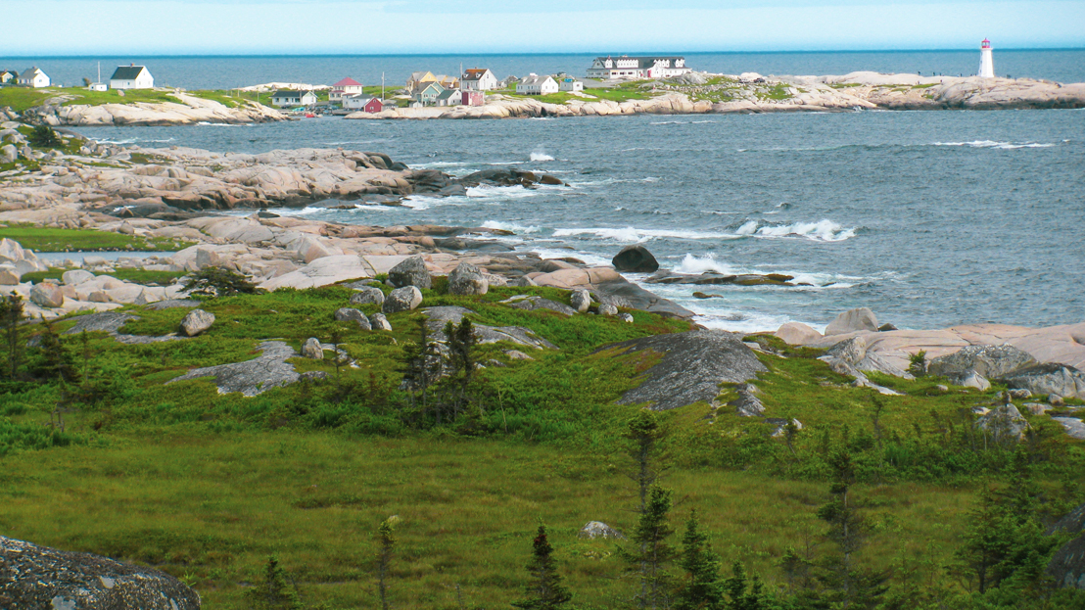


SAC 2020 – Summer School
Virtual Halifax, NS. October 19/20, 2020.

Slide 2

Summer School → “Summer” School
At first… “Fall is nice here too still”

Slide 3
Program Chairs
Michael J. Jacobson Jr. - University of Calgary
Orr Dunkelman – University of Haifa
Colin O’Flynn - Dalhousie University

Slide 4
Modern elliptic curve cryptography
Ben Smith, INRIA and École Polytechnique
This is a very short course on the foundations of modern elliptic curve cryptography. First, we will cover the basics on elliptic curves and their arithmetic, and the difficulty and inter-relationship of the Elliptic Curve Discrete Log and Elliptic Curve Diffie-Hellman problems. Then, we will dive into the design of state-of-the-art ECC protocols, including Curve25519/X25519 key exchange and contemporary elliptic curve signature schemes.

Slide 5
Polynomial systems of equations and their cryptographic aspects
Antoine Joux, CISPA Helmholtz-Zentrum
In this lecture, we will discuss several aspects of polynomial equations and their use in cryptography. We will first motivate the topic be showing some uses of such systems in cryptography. Then, we will turn to the cryptanalytic aspects, describing algorithmic techniques to solve such systems. In this part, we start be recalling the easy special cases before turning to the general case of non-linear multivariate systems (over finite fields). We will discuss three different approaches, exhaustive search, algebraic methods (aka as Groebner bases or XL computations) and probabilistic degree reduction (introduced by Lokshtanov et al.).

Slide 6
Can crypto help enhance democracy?
Jeremy Clark, Concordia University
Vanessa Teague, Thinking Cybersecurity and Australian National University
In this workshop, we will explore the world of voting technology. We will show you how cryptography can enhance the verifiability of an election, which is a challenge when a secret ballot needs to be obtained. We will discuss some real-world attempts at putting this type of cryptographic voting into practice. We will also discuss ways it can go wrong—from subtle cryptographic oversights to broader forms of cybersecurity attacks. Finally, we will focus on the issue of internet voting: if you can bank online, why can’t you vote online? It turns out there are a few good reasons.

Slide 7
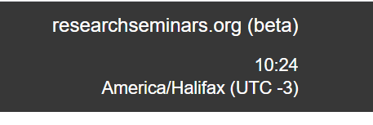
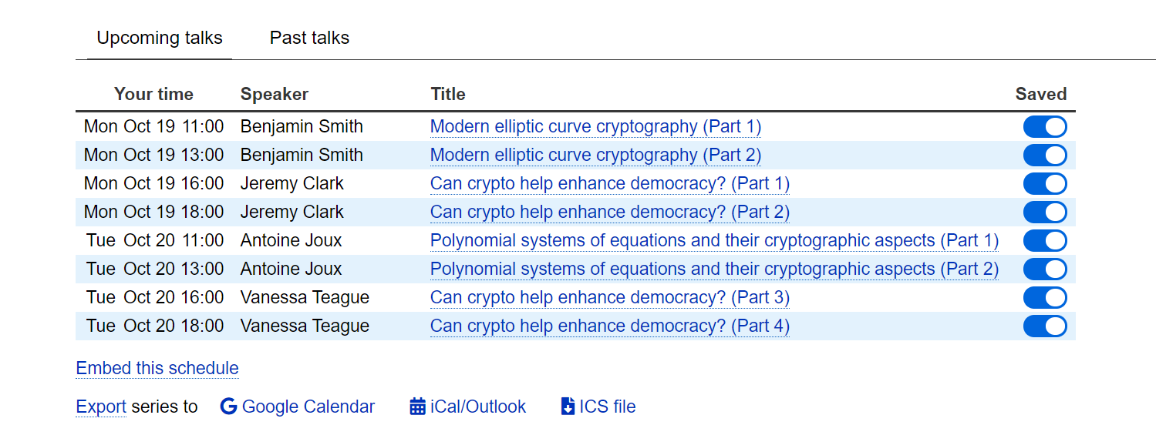
Summer School Schedules
https://researchseminars.org/seminar/SAC2020-School
Set your time zone here if the default is wrong (you will need to make an account)

Slide 8
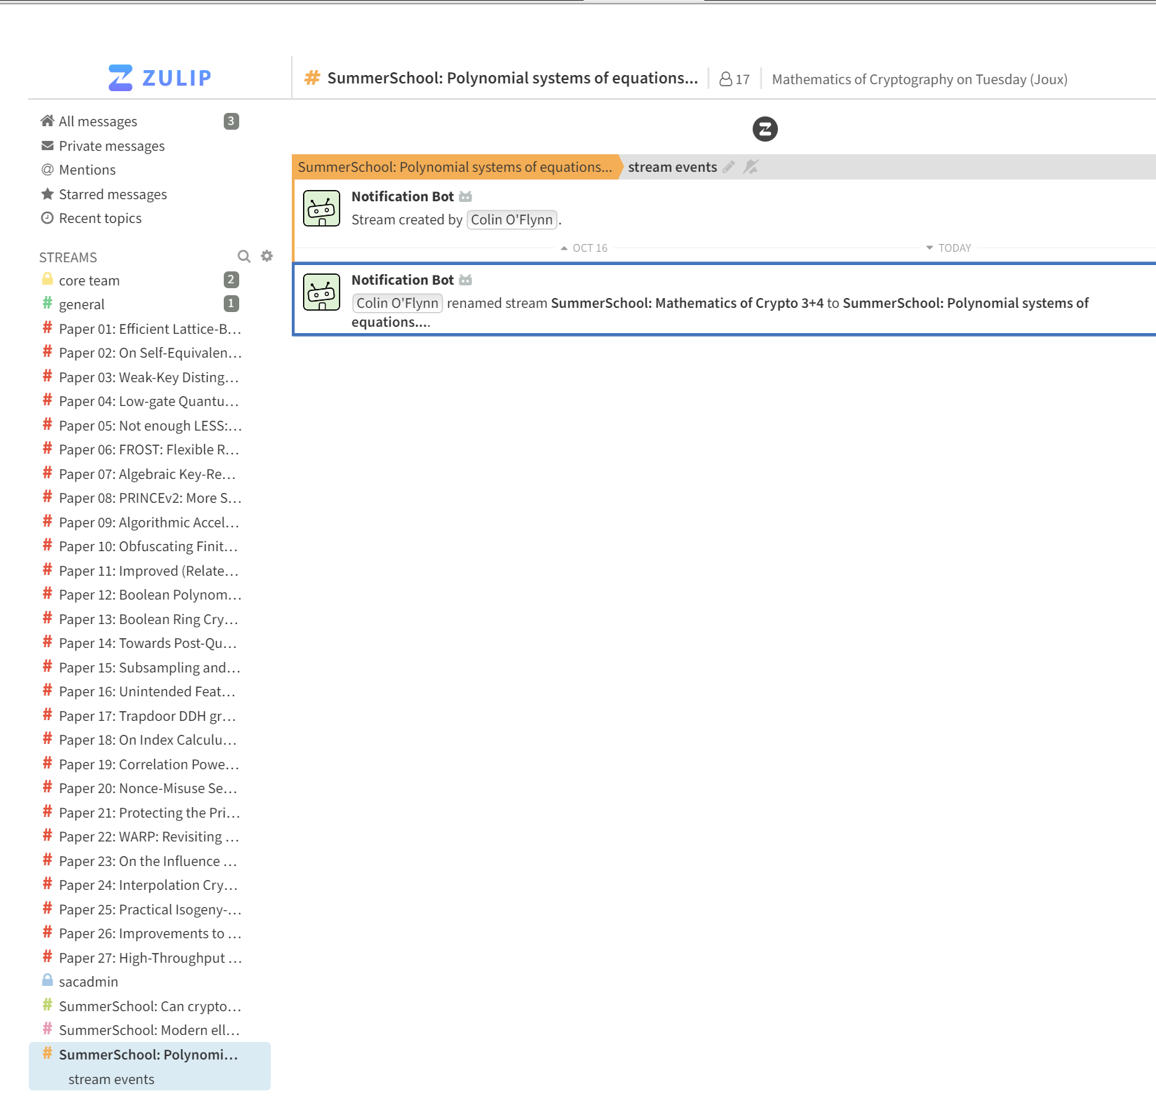
Zulip Chat System
https://sac2020.zulipchat.com/

Slide 9
Zoom Login Information
Please use Zoom to attend the Summer School event, with the following login details: https://ucalgary.zoom.us/j/94900361079 Meeting ID: 949 0036 1079 Passcode: 265663
Standard Zoom rules apply – please mute yourself except when needed.

Slide 10
SAC2020 Summer School Kick-Off
Welcome & enjoy yourself, hopefully it’s close to summer for you still…

